Slide 1
CPU Scheduling

Slide 2
Chapter 6: CPU Scheduling
Basic Concepts
Scheduling Criteria
Scheduling Algorithms
Multiple-Processor Scheduling
Real-Time CPU Scheduling
Operating Systems Examples

Slide 3

Basic Concepts
Maximum CPU utilization obtained with multiprogramming
CPU–I/O Burst Cycle – Process execution consists of a cycle of CPU execution and I/O wait
CPU burst followed by I/O burst
CPU burst distribution is of main concern

Slide 4
CPU Scheduler
Select a processor for execution
Short-term scheduler selects from among the processes in ready queue, and allocates the CPU to one of them
CPU scheduling decisions may take place when a process:
  1. Switches from running to waiting state
  2. Switches from running to ready state
  3. Switches from waiting to ready
  Terminates
Scheduling under 1 and 4 is nonpreemptive
All other scheduling is preemptive

Slide 5
Dispatcher
Dispatcher module gives control of the CPU to the process selected by the short-term scheduler; this involves:
  switching context
  switching to user mode
  jumping to the proper location in the user program to resume that program
Dispatch latency – time it takes for the dispatcher to stop one process and start another running. It should be minimum.

Slide 6
Scheduling Criteria
What do we want to achieve from scheduling (One of the following):
  Max CPU utilization – keep the CPU as busy as possible
  Max Throughput – # of processes that complete their execution per time unit
  Min Turnaround time – amount of time to execute a particular process
  Min Waiting time – amount of time a process has been waiting in the ready queue
  Min Response time – amount of time it takes from when a request was submitted until the first response is produced, not output (for time-sharing environment)

Slide 7
Non-Preemptive Scheduling
Under non-preemptive scheduling, once the CPU has been allocated to a process, the process keeps the CPU until it releases the CPU either by terminating or by switching to the waiting state.
This scheduling method is used by the Microsoft Windows 3.1 and by the Apple Macintosh operating systems.
It is the only method that can be used on certain hardware platforms, because.
It does not require the special hardware(for example: a timer) needed for preemptive scheduling.
In Preemptive Scheduling, the tasks are mostly assigned with their priorities.
Sometimes it is important to run a task with a higher priority before another lower priority task, even if the lower priority task is still running.
The lower priority task holds for some time and resumes when the higher priority task finishes its execution.
Preemptive Scheduling

Slide 8
CPU Scheduling Algorithms
FCFS(First Come First Serve) Algorithm
SJF(Shortest Job First) Algorithm
SRTF(Shortest Remaining Time First)
Priority Scheduling
Round Robin Scheduling
Multi Level Queue Scheduling

Slide 9
CPU Scheduling Algorithms
FCFS(First Come First Serve) Algorithm
Jobs are executed on first come, first serve basis.
It is a non-preemptive, pre-emptive scheduling algorithm.
Easy to understand and implement.
Its implementation is based on FIFO queue.
Poor in performance as average wait time is high.

Slide 10

First- Come, First-Served (FCFS) Scheduling
Process Burst Time
P₁ 24
P₂ 3
P₃ 3
Suppose that the processes arrive in the order: P₁ , P₂ , P₃
The Gantt Chart for the schedule is:
Waiting time for P₁ = 0; P₂ = 24; P₃ = 27
Average waiting time: (0 + 24 + 27)/3 = 17

Slide 11

FCFS Scheduling (Cont.)
Suppose that the processes arrive in the order:
P₂ , P₃ , P₁
The Gantt chart for the schedule is:
Waiting time for P₁ = 6; P₂ = 0; P₃ = 3
Average waiting time: (6 + 0 + 3)/3 = 3
Much better than previous case

Slide 12
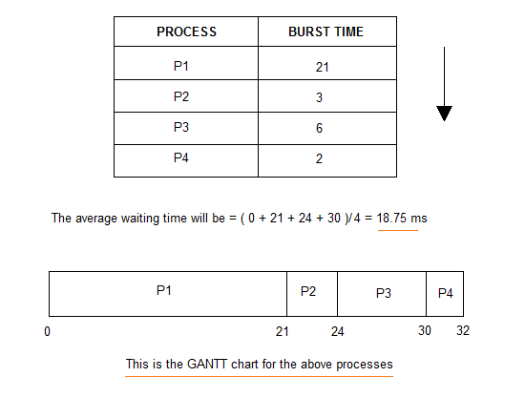
FCFS - Example 2

Slide 13
Problems with of FCFS
It is Non Pre-emptive algorithm, which means the process priority doesn't matter.
If a process with very least priority is being executed, more like daily routine backup process, the high priority process will have to wait, and hence in this case, the system will crash, just because of improper process scheduling.
Not optimal Average Waiting Time.
Poor resource(CPU, I/O etc) utilization.

Slide 14
CPU Scheduling Algorithms
SJF(Shortest Job First) Algorithm
This is also known as shortest job first, or SJF
This is a non-preemptive, pre-emptive scheduling algorithm.
Best approach to minimize waiting time.
Easy to implement in Batch systems where required CPU time is known in advance.
Impossible to implement in interactive systems where required CPU time is not known.
The processer should know in advance how much time process will take.

Slide 15
Shortest-Job-First (SJF) Scheduling
Associate with each process the length of its next CPU burst
  Use these lengths to schedule the process with the shortest time
SJF is optimal – gives minimum average waiting time for a given set of processes
  The difficulty is knowing the length of the next CPU request

Slide 16

Example of SJF
ProcessArriva l Time Burst Time
P₁ 0.0 6
P₂ 2.0 8
P₃ 4.0 7
P₄ 5.0 3
SJF scheduling chart
Average waiting time = (3 + 16 + 9 + 0) / 4 = 7

Slide 17
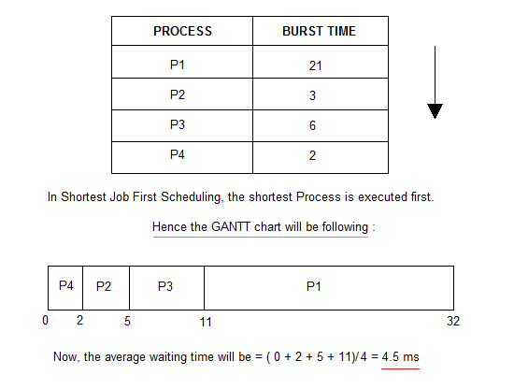
Non Pre-emptive Shortest Job First

Slide 18
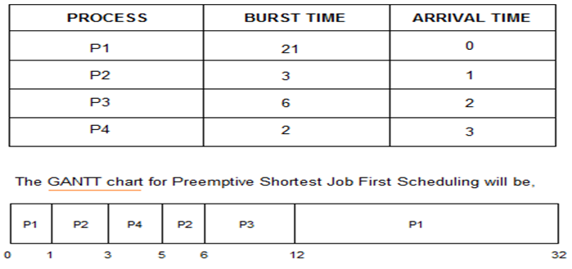
Pre-emptive Shortest Job First
Waiting Time
P1 → 12-1 = 11
P2 → 5-3 = 2
P3 → 6-2 = 4
P4 → 3-3 = 0
Avg. Waiting Time = (11+2+4+0)/4 = 17 / 4 = 4.25 ms

Slide 19
CPU Scheduling Algorithms
Priority Based Scheduling Algorithm
Priority scheduling is a non-preemptive algorithm and one of the most common scheduling algorithms in batch systems.
Each process is assigned a priority. Process with highest priority is to be executed first and so on.
Processes with same priority are executed on first come first served basis.
Priority can be decided based on memory requirements, time requirements or any other resource requirement.

Slide 20
Priority Scheduling
A priority number (integer) is associated with each process
The CPU is allocated to the process with the highest priority (smallest integer ≡ highest priority)
  Preemptive
  Non-preemptive
SJF is priority scheduling where priority is the next CPU burst time
Problem ≡ Starvation – low priority processes may never execute
Solution ≡ Aging – as time progresses increase the priority of the process

Slide 21
Example of Priority Scheduling
ProcessA arri Burst TimeT Priority
P₁ 10 3
P₂ 1 1
P₃ 2 4
P₄ 1 5
P₅ 5 2
Priority scheduling Gantt Chart
Average waiting time = 8.2 msec
P₂
P₅
P₁
P₃
P₄
0
1
6
16
18
19

Slide 22
CPU Scheduling Algorithms
Round Robin Scheduling Algorithm
Round Robin is the preemptive process scheduling algorithm.
Each process is provided a fix time to execute, it is called a quantum.
Once a process is executed for a given time period, it is preempted and other process executes for a given time period.
Context switching is used to save states of preempted processes.

Slide 23
Round Robin (RR)
Each process gets a small unit of CPU time (time quantum q)
  usually 10-100 milliseconds.
  After this time has elapsed, the process is preempted and added to the end of the ready queue.
If there are n processes in the ready queue and the time quantum is q,
  each process gets 1/n of the CPU
  No process waits more than (n-1)q time units.
Timer interrupts every quantum to schedule next process
Performance
  If q is large ⇒ FIFO
  q small ⇒ q must be large with respect to context switch time, otherwise overhead is too high
    context switch < 10 micro sec

Slide 24

Time Quantum and Context Switch Time

Slide 25
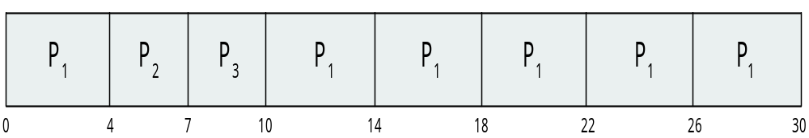
Example of RR with Time Quantum = 4
Process Burst Time
P₁ 24
P₂ 3
P₃ 3
The Gantt chart is:
Better response than SJF

Slide 26
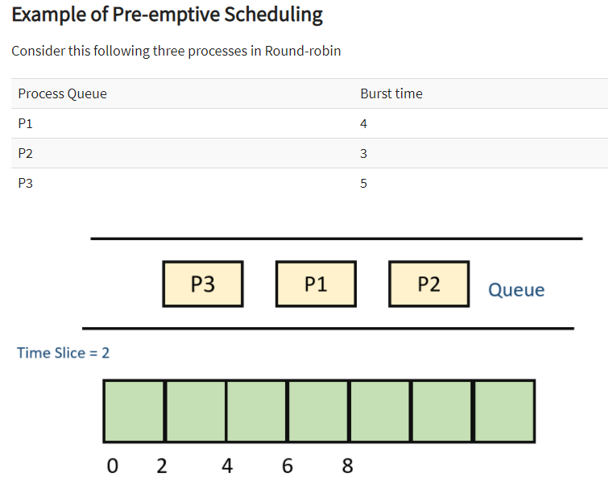
ROUND ROBIN

Slide 27
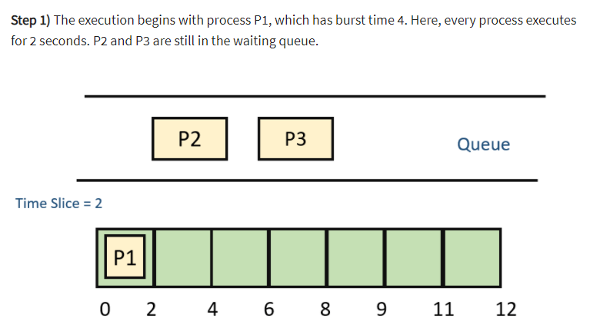
ROUND ROBIN

Slide 28
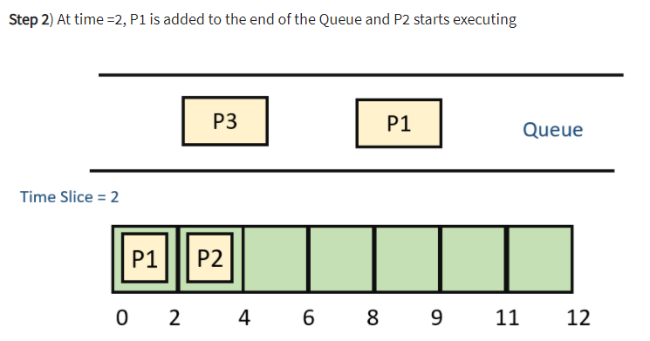
ROUND ROBIN

Slide 29
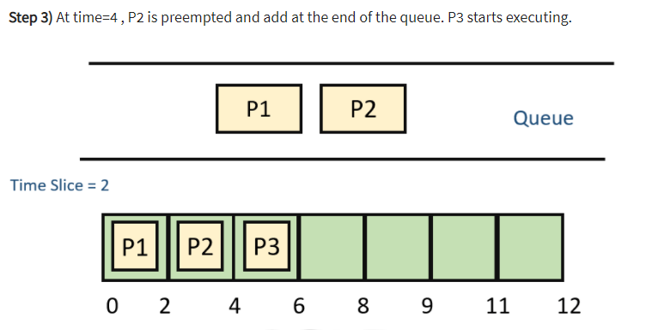
ROUND ROBIN

Slide 30
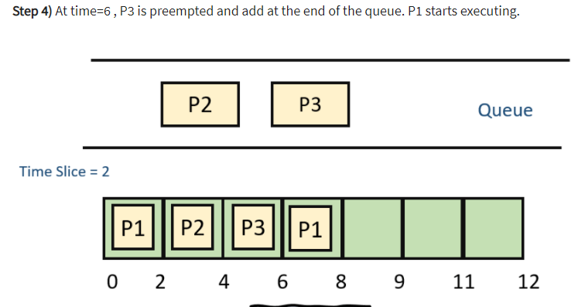
ROUND ROBIN

Slide 31
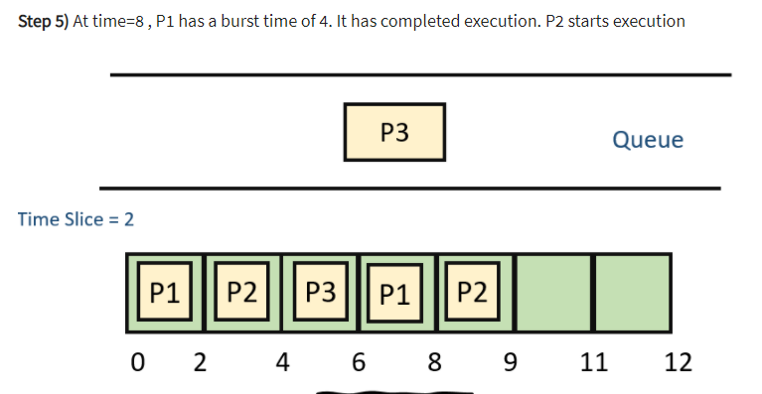
ROUND ROBIN

Slide 32
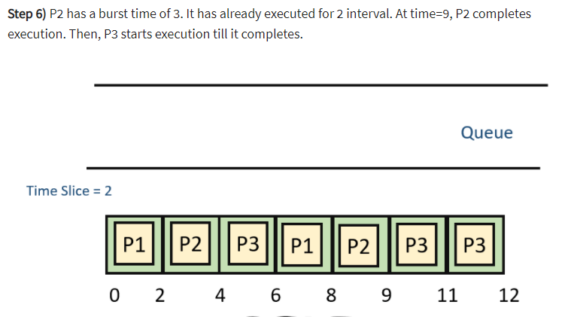
ROUND ROBIN

Slide 33
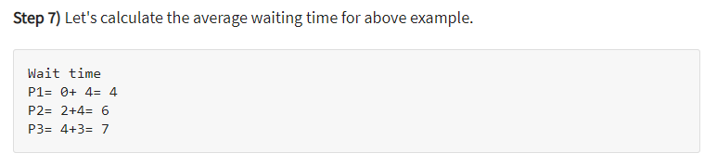
ROUND ROBIN

Slide 34
CPU Scheduling Algorithms
Shortest Remaining Time First Algorithm
Shortest remaining time (SRT) is the preemptive version of the SJN(Shortest Job Next) algorithm.
The processor is allocated to the job closest to completion but it can be preempted by a newer ready job with shorter time to completion.
Impossible to implement in interactive systems where required CPU time is not known.
It is often used in batch environments where short jobs need to give preference.

Slide 35
Example of Shortest-remaining-time-first
Now we add the concepts of varying arrival times and preemption to the analysis
ProcessA arri Arrival TimeT Burst Time
P₁ 0 8
P₂ 1 4
P₃ 2 9
P₄ 3 5
Preemptive SJF Gantt Chart
Average waiting time = [(10-1)+(1-1)+(17-2)+(5-3))]/4 = 26/4 = 6.5 msec

Slide 36
Multilevel Queue Scheduling
Processes in the ready queue can be divided into different classes where each class has its own scheduling needs.
A common division is a System process, foreground (interactive) process and background (batch) processes.
These three classes have different scheduling needs. For this kind of situation Multilevel Queue Scheduling is used.
For example, let us take three different types of process System processes, Interactive processes and Batch Processes.
All three process have there own queue.
Each queue have its own Scheduling algorithm.
For example, queue 1 and queue 2 uses Round Robin while queue 3 can use FCFS to schedule there processes.

Slide 37
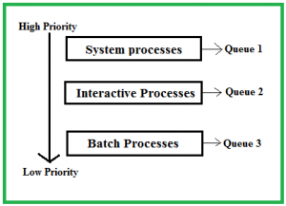
Multilevel Queue Scheduling

Slide 38
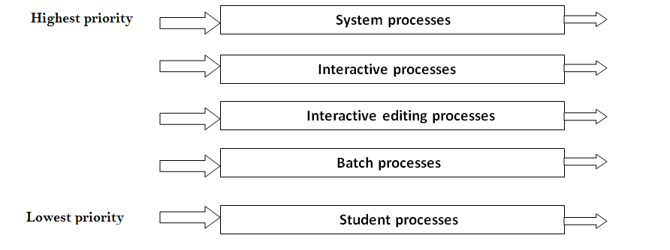
Multilevel Queue Scheduling

Slide 39
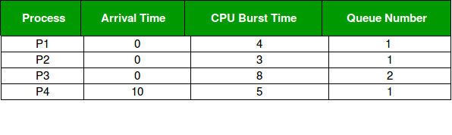

Example Multilevel Queue Scheduling
Priority of queue 1 is greater than queue 2.
Queue 1 uses Round Robin (Time Quantum = 2) and queue 2 uses FCFS.
Gantt Chart

Slide 40
Example Multilevel Queue Scheduling
Waiting Time of Process
P1 = 0
P2=6-2 =4
P3=15-3 = 12
P4=10-10=0
Avg. Waiting Time = (0+4+12+0)/4 = 4ms

Slide 41
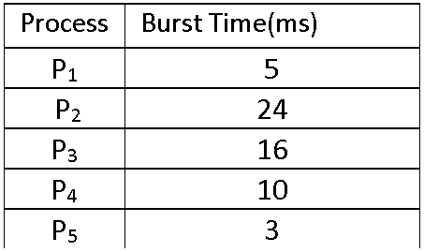
Example CPU Scheduling

Slide 42
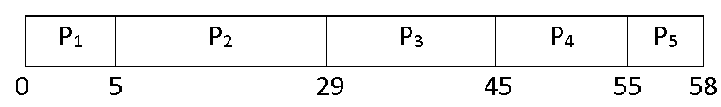
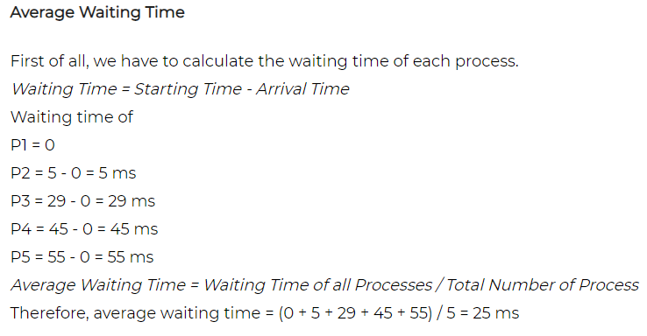
FCFS

Slide 43
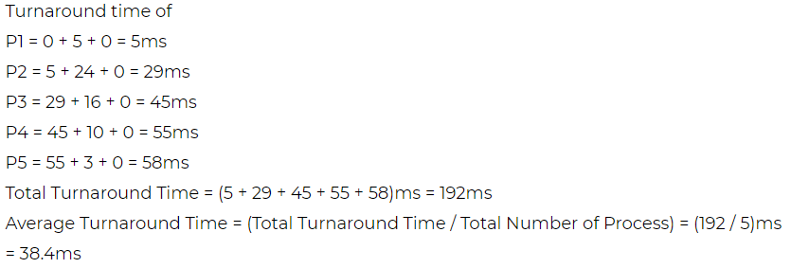
FCFS
Turnaround Time = Waiting Time + Burst Time

Slide 44
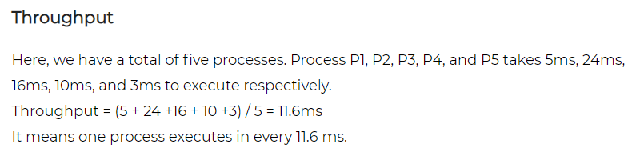
FCFS

Slide 45
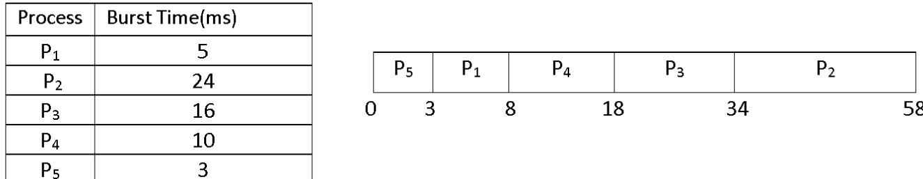
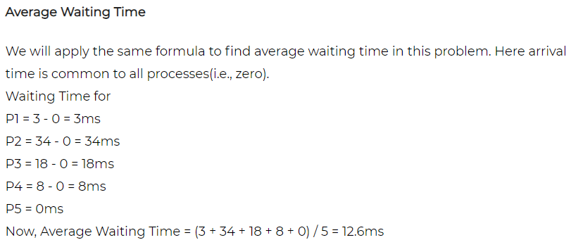
SJF

Slide 46
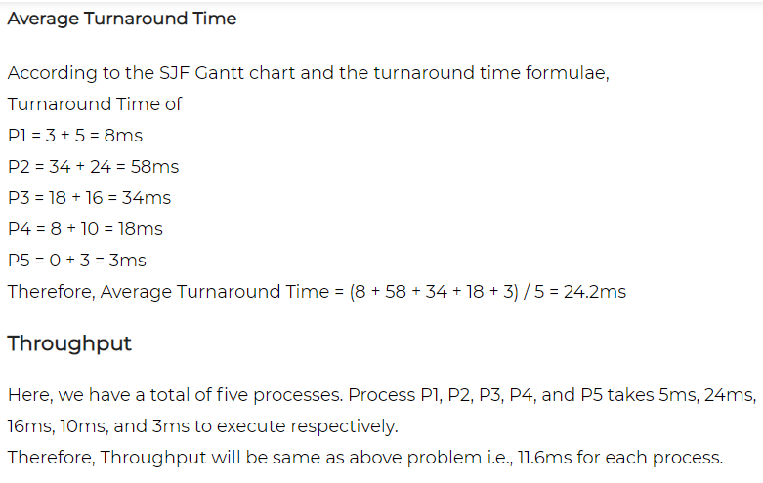
SJF

Slide 47
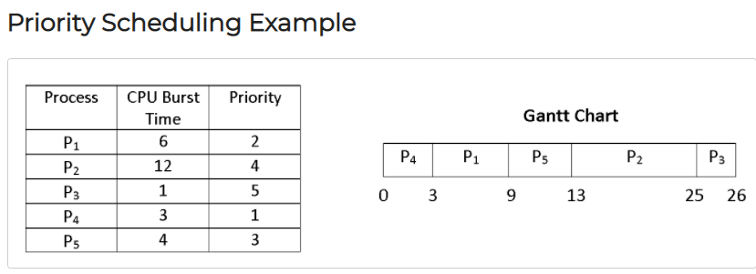
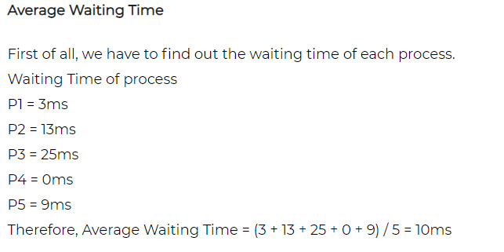

Slide 48
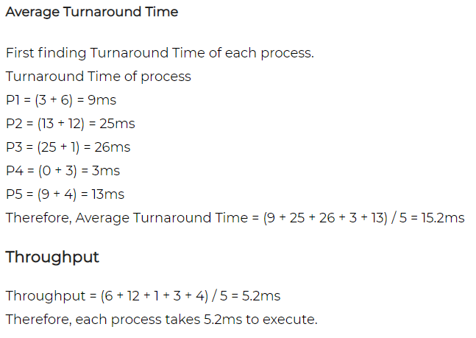

Slide 49
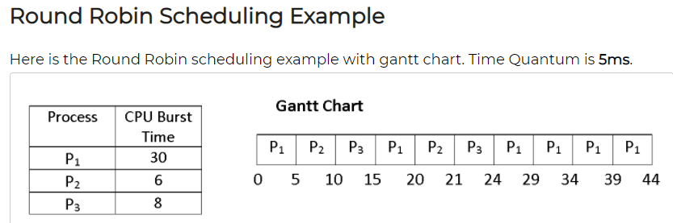
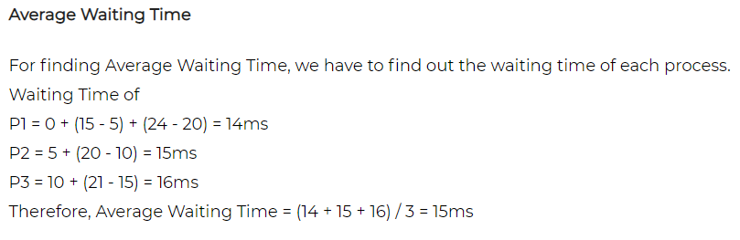

Slide 50
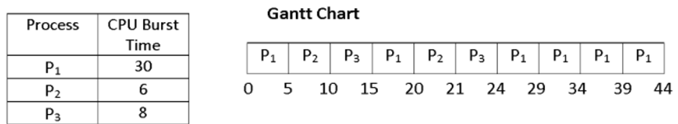
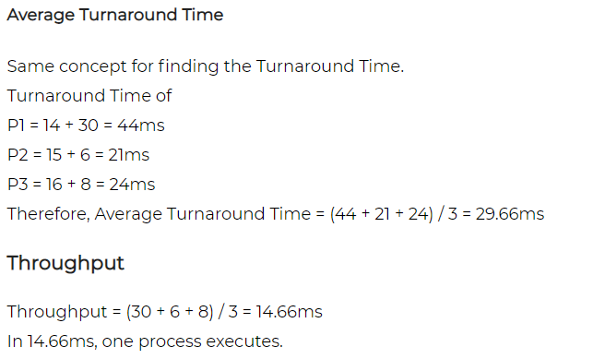
Round Robin Scheduling Example

Slide 51
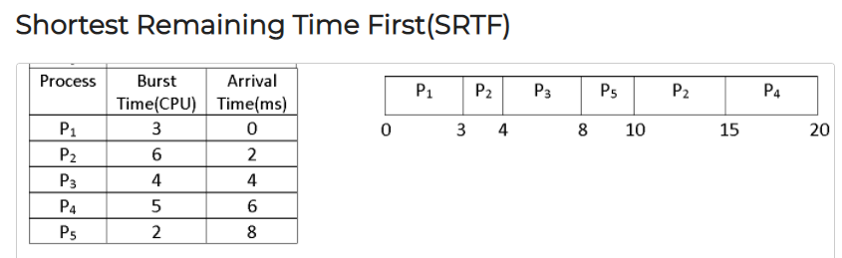
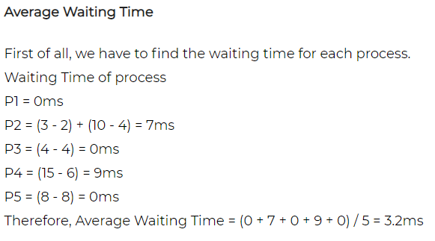

Slide 52
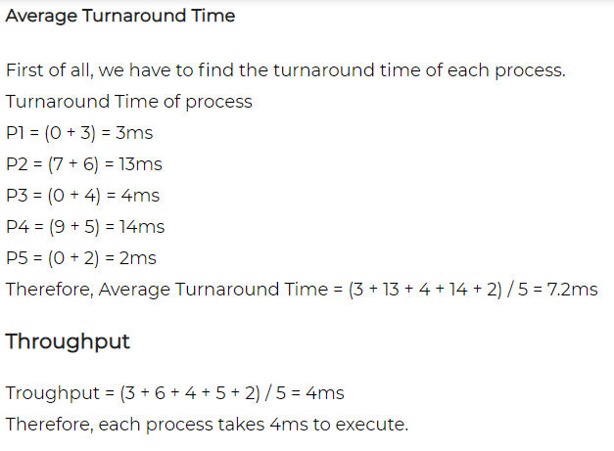

Slide 53
Linux Scheduling Through Version 2.5
Prior to kernel version 2.5, ran variation of standard UNIX scheduling algorithm
Version 2.5 moved to constant order O(1) scheduling time
  Preemptive, priority based
  Two priority ranges: time-sharing and real-time
  Real-time range from 0 to 99 and nice value from 100 to 139
  Map into global priority with numerically lower values indicating higher priority
  Higher priority gets larger q
  Task run-able as long as time left in time slice (active)
  If no time left (expired), not run-able until all other tasks use their slices
  All run-able tasks tracked in per-CPU runqueue data structure
    Two priority arrays (active, expired)
    Tasks indexed by priority
    When no more active, arrays are exchanged
  Worked well, but poor response times for interactive processes

Slide 54

Linux Scheduling (Cont.)
Real-time scheduling according to POSIX.1b
  Real-time tasks have static priorities
Real-time plus normal map into global priority scheme
Nice value of -20 maps to global priority 100
Nice value of +19 maps to priority 139

Slide 55
Linux Scheduling in Version 2.6.23 +
Completely Fair Scheduler (CFS)
Scheduling classes
  Each has specific priority
  Scheduler picks highest priority task in highest scheduling class
  Rather than quantum based on fixed time allotments, based on proportion of CPU time
  2 scheduling classes included, others can be added
    default
    real-time
Quantum calculated based on nice value from -20 to +19
  Lower value is higher priority
  Calculates target latency – interval of time during which task should run at least once
  Target latency can increase if say number of active tasks increases
CFS scheduler maintains per task virtual run time in variable vruntime
  Associated with decay factor based on priority of task – lower priority is higher decay rate
  Normal default priority yields virtual run time = actual run time
To decide next task to run, scheduler picks task with lowest virtual run time

Slide 56
Windows Scheduling
Windows uses priority-based preemptive scheduling
Highest-priority thread runs next
Dispatcher is scheduler
Thread runs until (1) blocks, (2) uses time slice, (3) preempted by higher-priority thread
Real-time threads can preempt non-real-time
32-level priority scheme
Variable class is 1-15, real-time class is 16-31
Priority 0 is memory-management thread
Queue for each priority
If no run-able thread, runs idle thread

Slide 57
Windows Priority Classes
Win32 API identifies several priority classes to which a process can belong
  REALTIME_PRIORITY_CLASS, HIGH_PRIORITY_CLASS, ABOVE_NORMAL_PRIORITY_CLASS,NORMAL_PRIORITY_CLASS, BELOW_NORMAL_PRIORITY_CLASS, IDLE_PRIORITY_CLASS
  All are variable except REALTIME
A thread within a given priority class has a relative priority
  TIME_CRITICAL, HIGHEST, ABOVE_NORMAL, NORMAL, BELOW_NORMAL, LOWEST, IDLE
Priority class and relative priority combine to give numeric priority
Base priority is NORMAL within the class
If quantum expires, priority lowered, but never below base

Slide 58

Windows Priorities

Slide 59
End of Chapter 6

